Slide 1
Topic 2 :LEARNING HOW TO LEARN AND LEARN FAST
Pham Minh Nhut

Slide 2
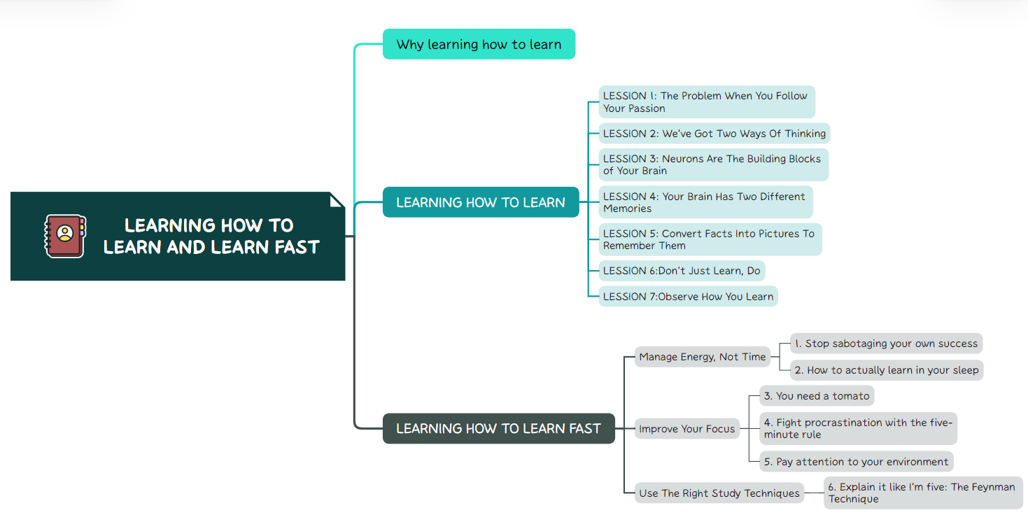
Why learning how to learn and learn fast

Slide 3

Why learning how to learn and learn fast
1.
2.
3.
4.
Adaptability
Problem Solving
Continuous Improvement
Competitive Advantage
5.
Efficient Time Management
6.
Enhanced Creativity

Slide 4
LEARNING HOW TO LEARN

Slide 5
LESSON 1
01
The Problem When You Follow Your Passion

Slide 6
“I realized that by only following my passion, I didn’t have many choices.”
“
—Barbara Oakley

Slide 7

You need to change your thinking about studying
You should go outside your comfort zone. Broaden your passions

Slide 8
What is the main barrier that prevents you from facing difficult challenges?

Slide 9
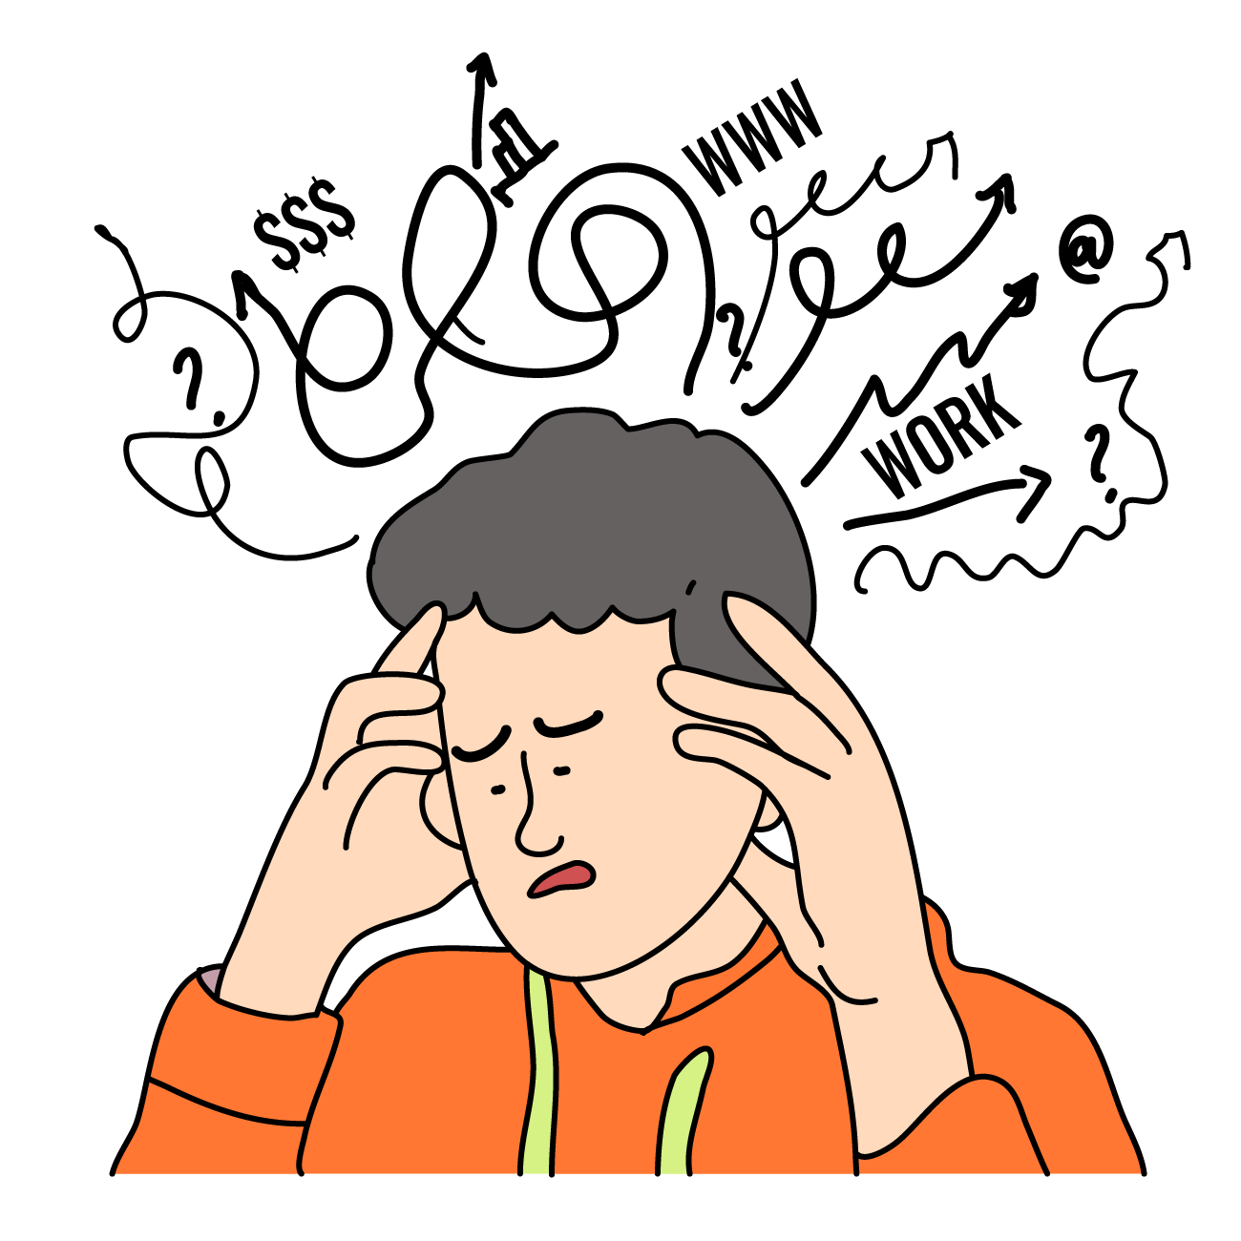
Is it your ability to learn?
Lack of Foundation Knowledge
Ineffective Learning Methods
Lack of Motivation and Interest
High Expectations
Pressure and Stress
Unfavorable Learning Environment
It’s not our thing. It’s too hard for me.
→ But not the subject is hard, we simply don’t know how to learn

Slide 10
“It’s easy to believe that you should only concentrate on subjects that come easily for you. But my story reveals that you can do well in subjects you don’t even like. The truth is, it’s okay to follow your passions. But I also found that broadening my passions opened many wonderful opportunities. Learning new subjects I didn’t think I could do turned out to be an adventure!”.
“
—Barbara Oakley

Slide 11
The Problem When You Follow Your Passion
1.
1.
2.
Broaden our passions and open ourselves to many other wonderful opportunities.
If you improve your learning skills, you can greatly improve your life.

Slide 12
02
LESSON 2
We’ve Got Two Ways of Thinking

Slide 13
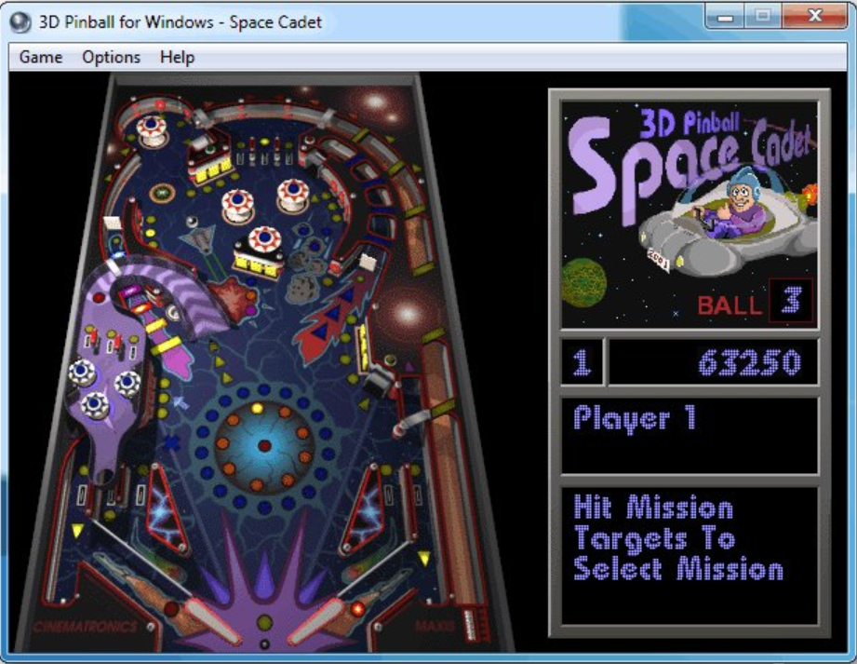
Focused mode
Focus mode is all about focusing on a specific subject and nothing else seems to matter.
The more you focus while you learn, the stronger the pathways.

Slide 14
Diffuse mode
Diffuse mode is practically daydreaming.
Your thinking is much broader .Help you to see the broader picture.

Slide 15
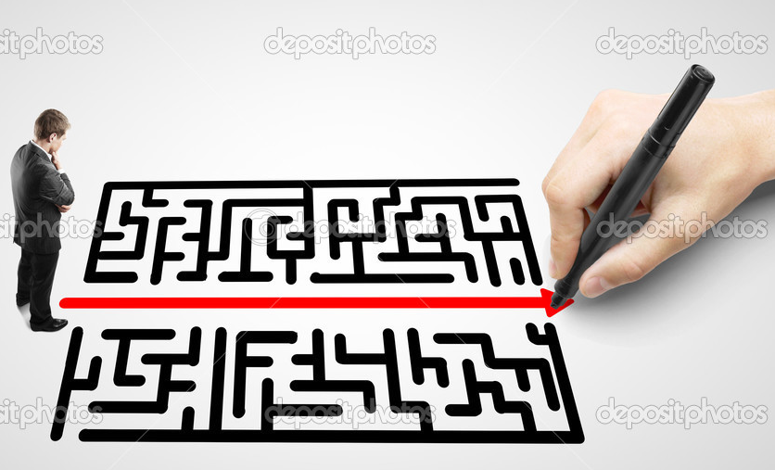
We are focused on the problem
We ignite only the pathways that we previously created
That's not enough to solve a difficult problem
Need to different concepts from other domains.
→ At this point you should enter diffuse mode

Slide 16

What do you need to do next when in diffuse mode?
Step Away from the Issue
Focus on other issues
Link the Problem to Other Knowledge Create Connections with Different Aspects
=>This is the foundation of the Pomodoro technique

Slide 17
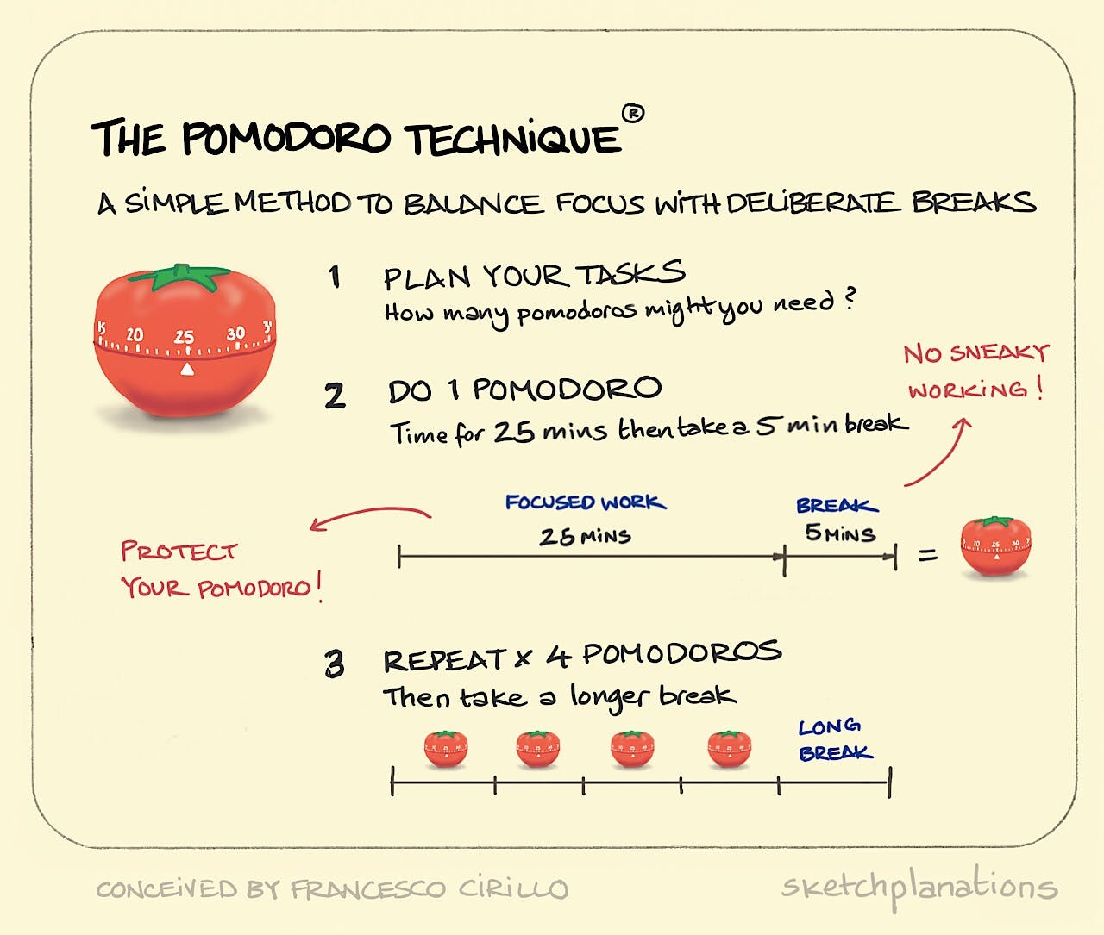
Pomodoro technique
Here’s how it works:
Set your timer for 25 minutes.
Study. Don’t interrupt your learning session for anything
Once the timer rings, stop immediately.
Take a quick break of five minutes. Avoid overly stimulating activities
Repeat two or three more times before taking a longer break.

Slide 18
“This is why, when you’re stuck on a math problem, you can instead switch your focus to studying geography for a while. Then you can make a breakthrough when you return to the math. But it seems that the best ways to give your diffuse mode a chance to work out a difficult problem are through activities like sleeping, exercising, or going for a ride in a vehicle.”
“
—Barbara Oakley

Slide 19
03
LESSON 3
Neurons Are The Building Blocks of Your Brain

Slide 20
How do we remember to do our job ?
To perform complicated tasks without having to look at the manual every time?

Slide 21
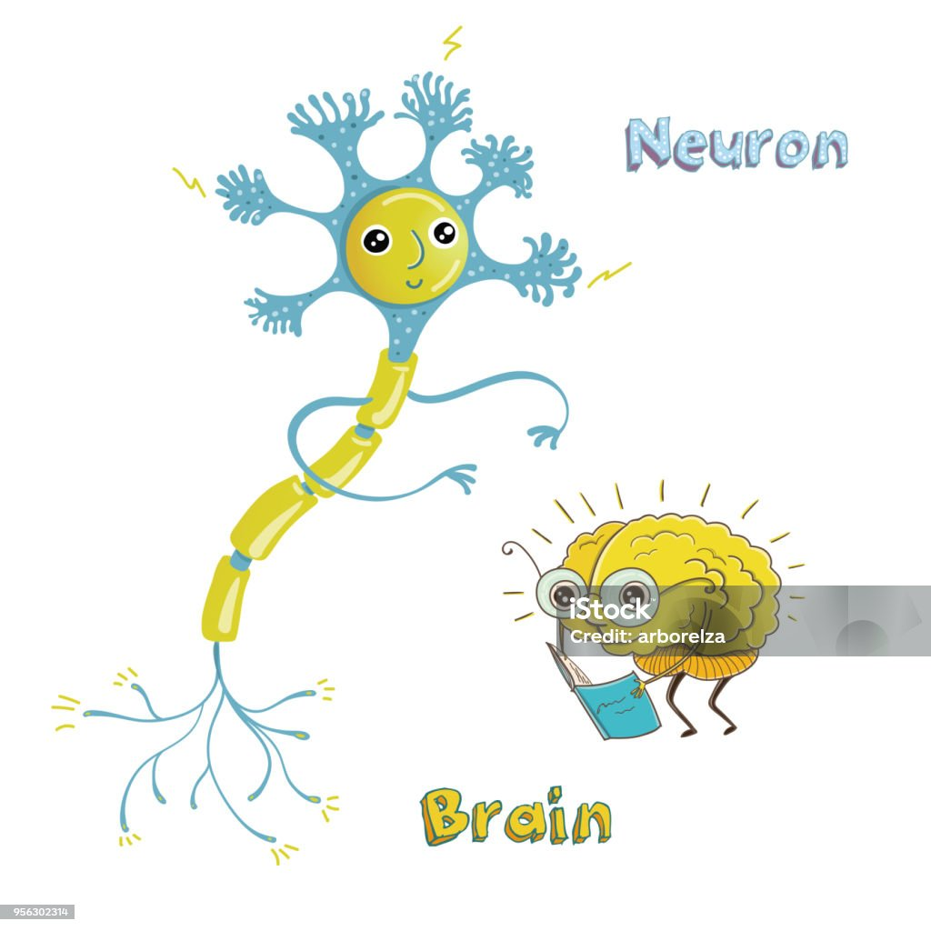
AGENDA
They have:
One head.
Two legs with many small spines.
An arm grew from his head.

Slide 22
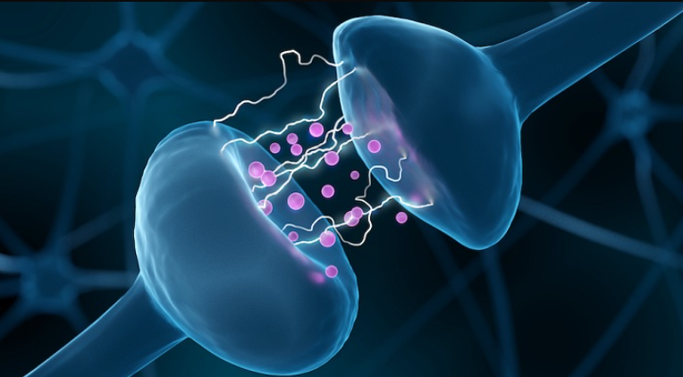
How do we remember to do our job?
Based on the conversation between neurons.
Neurons send signals to other neurons by giving them a little shock.
The more neurons shock each other – talk to each other.
The bigger the shock and the greater the connection.

Slide 23
“The neuron-aliens are like friends who become better friends because they talk a lot…You can think of the “wiring together” as creating a set of brain-links. Learning something new means creating new or stronger links in your brain.”
“
—Barbara Oakley

Slide 24

Perform complex tasks ?
Understanding how to perform a complicated task means that you created enough strong brain links in your head.

Slide 25
Perform complex tasks ?
By practicing:
Your neurons will build connections with other neurons.
Practice more:
These connections are becoming stronger and stronger
=>Creating knowledge that looks like a steel chain. Or even, like a well-paved road.

Slide 26

For instance
If you learn to speak English. You’ll create dozens of neurons. The connection between them can look like a highway.
When someone speaks English, the pathways are activated, allowing you to reply smoothly in English.

Slide 27
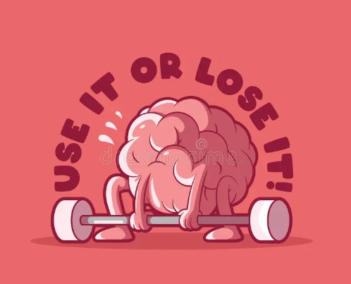
weakness
why we forget ?
If you stop practicing a particular activity
The neurons will stop talking.
what you’ve previously learned will begin to crumble.

Slide 28
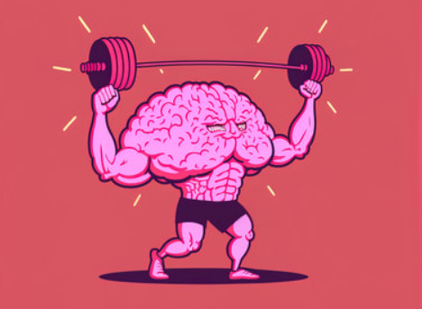
The good thing is that we can always build connections or rebuild them
But we must practice long enough to build strong connections

Slide 29
“The fact that trails in your brain can change and grow is called neuroplasticity. (It’s pronounced “new-row-plas-TI-sity.”) This fancy word just means that your neurons are like clay you can mold. That is, your neurons can change. This is why you can change!”.
“
—Barbara Oakley

Slide 30
04
LESSON 4
Your Brain Has Two Different Memories

Slide 31

Working Memory
Your working memory – is exactly like an actual bag.
You can put stuff inside and carry it around
The downside is that you can’t put a lot of things inside
There are limits
The thing to say is that there's an attention octopus inside.

Slide 32

Working Memory
The way we handle incoming information can be visualized as an octopus.
Depending on its age and how its brain works, your octopus may have four, five- or more - arms.
The number of arms your octopus has corresponds to the number of ideas you can hold in your head.

Slide 33
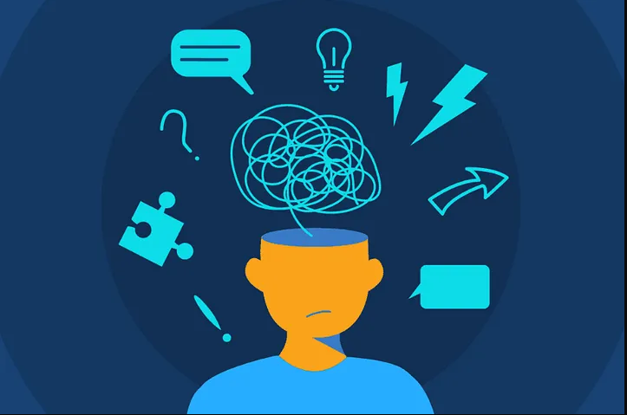

Working Memory
If you are to meet three people at this moment. You tell them your name, and they say theirs. There is a chance that you won’t “hold” all of the three names.
→ Because you aren’t focusing on hearing and remembering their names

Slide 34

you should simply focus
Concentrate on the task and put aside other thoughts

Slide 35
Long-Term Memory
Long-term memory is described as your “locker” memory.You can store a lot of information inside.
But there are two downside.

Slide 36

Long-Term Memory
Firstly, most of the things you know, are scattered around your brain
=>This makes it harder to recall stuff you need at this moment.
The second thing is that you have to “reach” for the memories inside your locker memory
=>This means that you need time to remember things

Slide 37
Your Brain Has Two Different Memories
1.
1.
2.
Working Memory
Concentrate on the task and put aside other thoughts
Long-Term Memory
Remembering faster, happens through practice.

Slide 38
“In any case, your octopus can get tired. It can hold on to information for just a little while—maybe ten to fifteen seconds. Then the information begins to slip away unless you concentrate or repeat it to hold it in mind.”.
“
—Barbara Oakley

Slide 39
05
LESSON 5
Convert Facts Into Pictures To Remember Them

Slide 40

learning how to better remember things – is much more valuable.

Slide 41
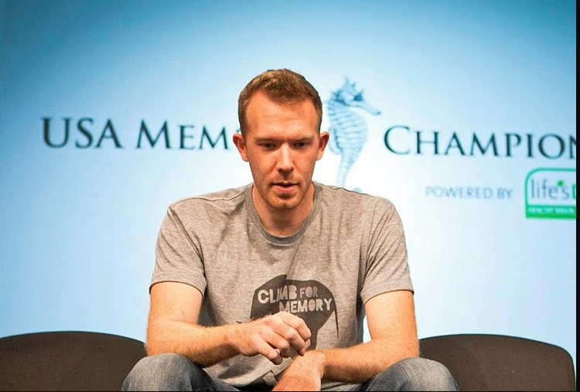
Nelson Dellis, 35 years old
The author of the book "Remember It," a four-time U.S. Memory Champion (an annual competition for outstanding intellectual athletes).

Slide 42

Nelson shares a few tips:
Focus
Remind yourself to concentrate when capturing information
Store it
Relate new information to existing knowledge for better retention
Practice
Regular practice is essential for improving memory.
Recall
Actively recall gathered information
Picture things
Convert facts into memorable images with movement

Slide 43
06
LESSON 6
Don’t Just Learn, Do

Slide 44

Don’t Just Learn, Do
The key to learning isn’t accumulating more knowledge but engaging in more practical application.
Forming stronger brain connections can only be achieved by actively practicing what you've just read or watched

Slide 45

Psychological factors
Don’t Just Learn, Do
We frequently get stuck and don’t move forward because we get used to what we know.
Get used to what we can do and don’t try new stuff.
For instance:
If you know how to play a couple of songs on the piano. This can mean that you are a good musician. But you are far from being the best.

Slide 46

Things you should do:
The goal is to continually push yourself.
Learn something new and then try that new piece.
Practice it until you know it.

Slide 47
Don’t Just Learn, Do
Key psychological factors contributing to effective learning
Active Learning
Engaging in proactive application after acquiring new knowledge
Active Recall:
Bringing back learned information without referring to notes
Cognitive Load:
Managing information flow is crucial.
Deliberate Practice:
Focusing on challenging material rather.
Interleaving:
Trying diverse techniques or exploring different perspectives.

Slide 48
07
LESSON 7
Observe How You Learn

Slide 49
Try to answer a couple of questions
1.
4.
2.
3.
What new knowledge did you gain today?
Areas for improvement?
How did your learning experience unfold?
What factors influenced your learning?
5.
What did you excel at today?
When did you conclude your learning activities?
6.

Slide 50
Why should you do that?
The main idea is to regularly reflect on your days. Try to spot patterns. With these insights, make some changes and start observing again.

Slide 51
Additional tips to enhance learning:
Study in different places:
1.
Avoid studying in the same place all the time.
2.
Try different materials:
Mixing sources, such as watching videos and reading.
15
3.
Set quitting time:
Having a defined schedule helps improve concentration.

Slide 52
08
Actionable Notes

Slide 53
1.
2.
3.
4.
Actionable Notes
Use metaphors
Active recall
Memory palace technique
Avoid rut think
5.
Thinking fast and slow

Slide 54
LEARNING HOW TO LEARN FAST

Slide 55
Manage Energy, Not Time

Slide 56
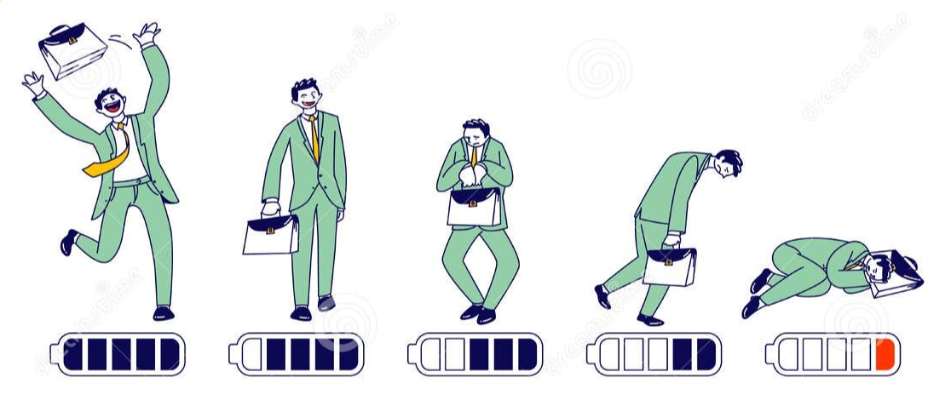
Manage Energy, Not Time
You need to invest energy
Energy as the most relevant resource in your learning endeavor
Your brain’s:
Ability to grasp new concepts
Come up with new ideas
It doesn't depend so much on the time
It depends more on your state of mind and available energy.

Slide 57
01
Stop sabotaging your own success

Slide 58

Sleep deprivation is associated with:
Poor performance across various aspects
Slow down the formation of your long-term memory.

Slide 59
While all-nighters make for good stories, they won’t do much for you in terms of learning effectively.
Instead of measuring the quantity of study time, we should prioritize the quality.

Slide 60
The Problem When You Follow Your Passion
1.
1.
2.
Broaden our passions and open ourselves to many other wonderful opportunities.
If you improve your learning skills, you can greatly improve your life.

Slide 61
02
How to actually learn in your sleep

Slide 62
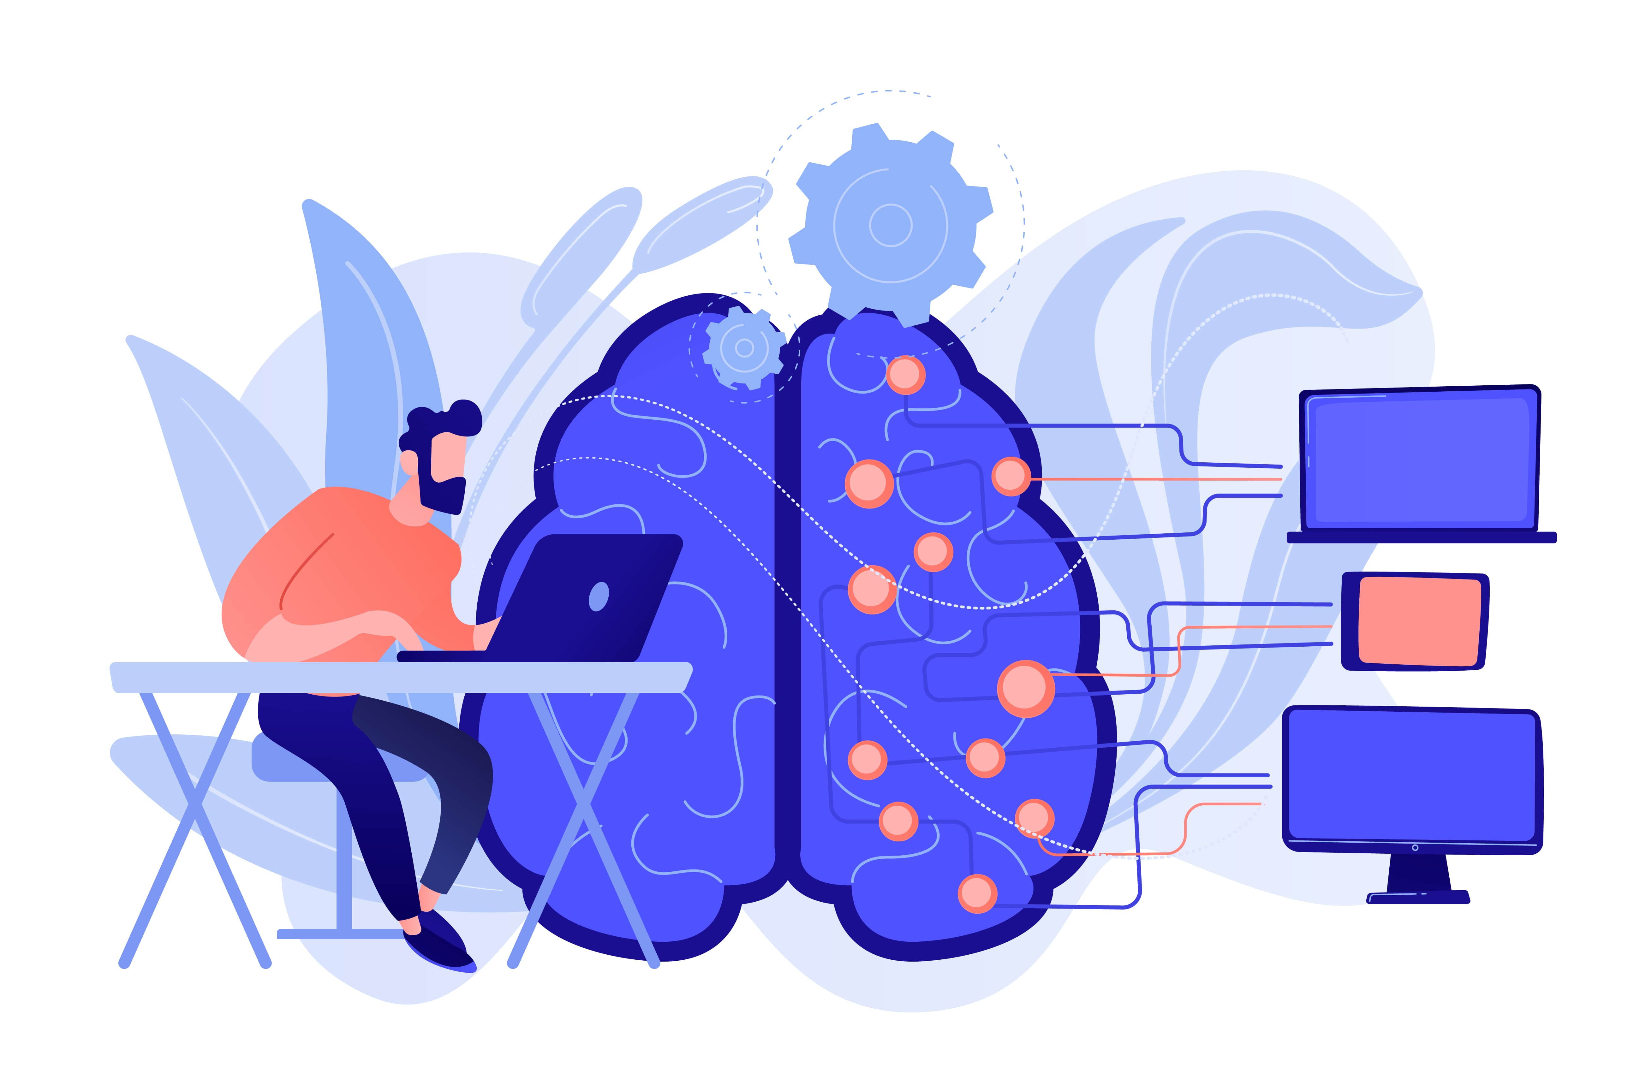
I have bad news and good news for you
The bad news : if you're hoping to learn something by playing a lecture in the background, it won't work.
The good news: however, is that you really can learn in your sleep.

Slide 63

So-called slow-wave or non-REM sleep cycles help your brain:
Turns short-term inputs into long-term memories.
Find patterns and connections to existing ideas
Reset the brain's ability to receive new information.

Slide 64
Good night's sleep
Even though you can't use sleep time to put more information into your brain.
But it is important to organize what you learned during the day and ensure that you remember it long term.

Slide 65
GOOD NIGHT’S SLEEP
Here are some ideas for better sleep:
No caffeine after 2pm.
Establish a night and morning routine
Avoid highly stimulating activities before bed
Improve your sleeping environment

Slide 66
Improve Your Focus

Slide 67
“Focus” in this context means your ability to actually sit down and study a topic
No matter how much energy you’ve got, if you can’t channel it into your learning project
=> If won’t be of much use.

Slide 68
03
You need a tomato

Slide 69
HERE’S HOW IT WORKS
Set your timer for 25 minutes.
Don’t interrupt your learning session for anything
Once the timer rings, stop immediately.
Take a quick break of five minutes.
Avoid overly stimulating activities
Repeat two or three more times before taking a longer break.

Slide 70
WHY DOES IT WORK ?
Multitasking is a myth
Your brain is not set up to do two things at once.
Instead, it quickly switches between tasks
Each switch costs mental bandwidth
Research shows that it can take up to 25 minutes to get back into a focused state.

Slide 71
Fight procrastination with the five-minute rule
04

Slide 72
Potential reasons for procrastination
A task might be perceived as too difficult Fear of Failure
Lack of Confidence
Lack of Interest
This is where the five-minute rule applies-a simple trick to convince yourself

Slide 73
The next time you feel procrastination creeping in, make a deal with yourself to get started on the task for five minutes only
“

Slide 74
05
Pay attention to your environment

Slide 75
Design environment to support study
1.
3.
2.
4.
Put your phone in a different room and make it hard to access YouTube.
Separate your study space from your relaxation space.
Set up a simple routine at the beginning of each study session
Tidying up a room and decluttering your desk

Slide 76
Use the Right Study Techniques

Slide 77
06
Explain it like I’m five: the Feynman Technique

Slide 78
What is the Feynman technique?
Coined after the famous physicist Richard Feynman
The Feynman Technique:
Breaking an idea or concept down into its components
Explaining it (in your own words) as simply as possible.

Slide 79
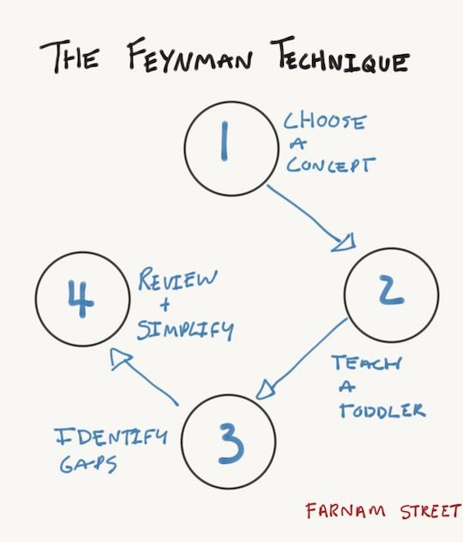
Apply the Feynman technique to a topic
Step 1: Choose a concept/topic to learn
Step 2: Explain the concept in a simple way according to your understanding
Step 3: Identify gaps in knowledge of the topic for further research
Step 4: Simplify the information and repeat the process

Slide 80
THANKS FOR WATCHING
Pham Minh Nhut

